Slide 1
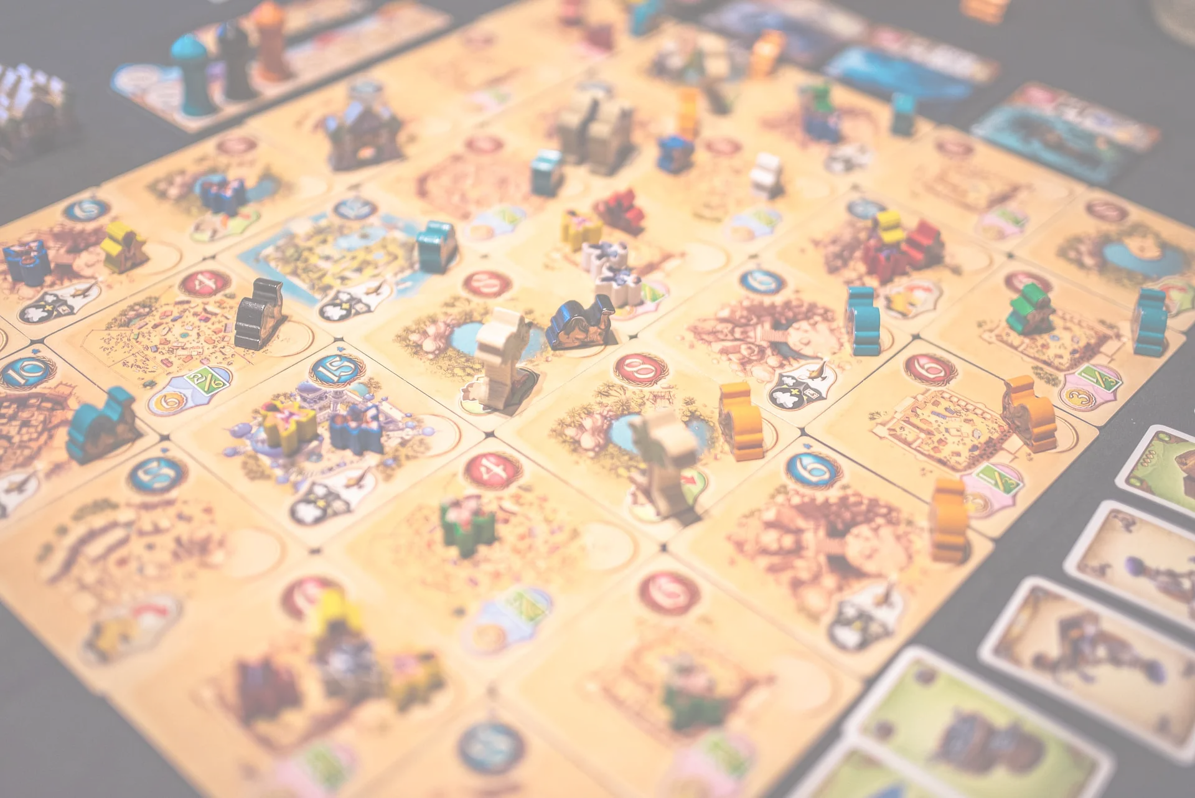
Tribes
by
Adoxus - methane

Slide 2
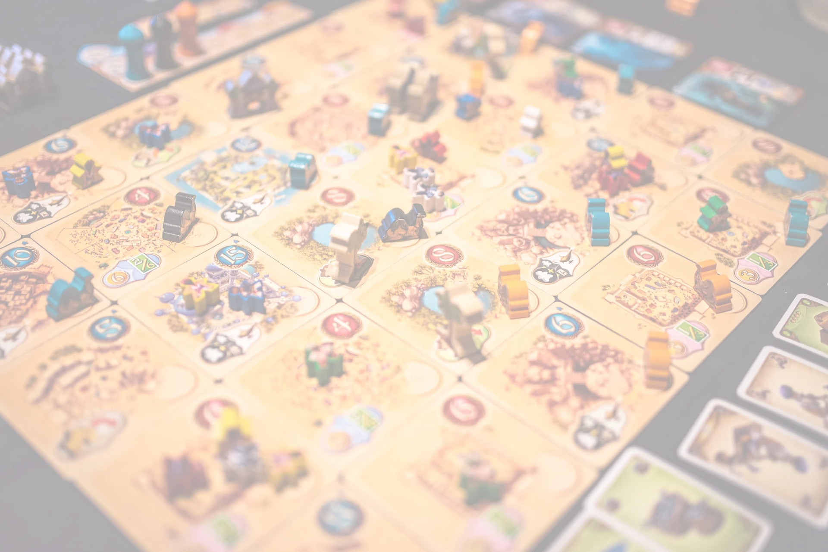
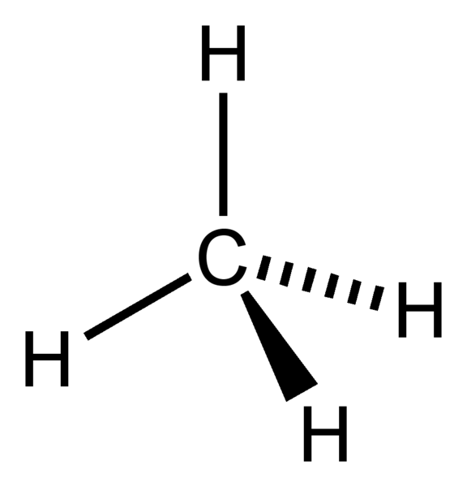
Adoxus - methane
Group:
Csikai Tamás László
Gárdonyi Márk
Soós Gábor
Szűcs Alexandra
Mentor:
Tamás Péter (Kond)

Slide 3
User stories completed by Márk
Endpoints:
POST /register
GET /players
POST /kingdom/buildings
GET /kingdom/troops/{id}
Entities:
Player
Kingdom
Location
Other functions:
Timeservice
Update resources

Slide 4
Code sniplet – GET /players
public PlayerListDTO findNearbyPlayers(Player authPlayer, Integer distance) { distance = distance == null ? DEFAULT_DISTANCE : distance; int currentX = authPlayer.getKingdom().getLocation().getxcoordinate(); int currentY = authPlayer.getKingdom().getLocation().getycoordinate(); List<RegistrationResDTO> nearbyPlayerDTOs = playerRepository.findAllNearBy( currentX - distance, currentX + distance, currentY - distance, currentY + distance).stream() .filter(p -> p.getId() != authPlayer.getId()) .map(RegistrationResDTO::new) .collect(Collectors.toList()); return new PlayerListDTO(nearbyPlayerDTOs); }

